Slide 1

Review and Next Steps
API Documentation 1: JSON and XML
What have you learned? What's next?

Slide 2
Introduction
Review of the course
APIs
Data types
JSON
XML
Tools
Next steps
Documenting REST APIs

Slide 3


Web APIs
API request
API response
Not a full web page ─ just the data!
Software developers need to know:
What the request looks like so that the server can understand it
What the response looks like so that they can make sense of the data.

Slide 4
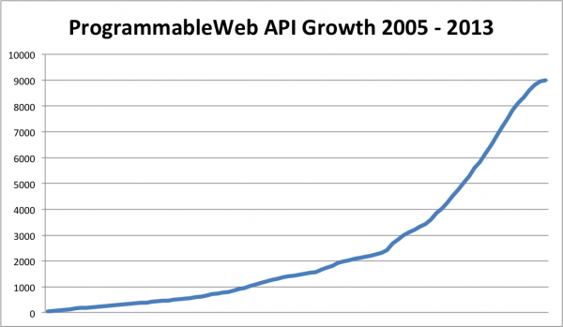
How many public APIs are there?

Slide 5
JSON basic data types
{
"Monday": {
"description": "sunny",
"maxTemp": 22,
"minTemp": 20,
"windSpeed": 12,
"danger": false
}
}

Slide 6
JSON complex data types
{
"song":
{
"title": "Hey Jude",
"artist": "The Beatles",
"musicians":
["John Lennon", "Paul McCartney",
"George Harrison", "Ringo Starr"]
}
}

Slide 7
Song JSON Documentation
Represents a song.
Element |  | Description | Type | Notes
song |  | Top level | song data object
 | title | Song title | string
 | artist | Song artist | string
 | musicians | A list of musicians who play on the song | array of string

Slide 8
XML with few attributes
<?xml version="1.0" encoding="UTF-8" ?>
<song language="en">
<title>Hey Jude</title>
<artist>The Beatles</artist>
<musicians>
<musician>John Lennon</musician>
<musician>Paul McCartney</musician>
<musician>George Harrison</musician>
<musician>Ringo Starr</musician>
</musicians>
</song>

Slide 9
Song XML Documentation
Represents a song.
Element |  |  | Description | Type | Notes
song |  |  | Top level | song data object | Attributes: language:Two letter language code.
 | title |  | Song title | string
 | artist |  | Song artist | string
 | musicians |  | A list of musicians who play on the song | JSON: array of string XML: array of musician
 |  | musician | The name of a musician | string

Slide 10
XML with many attributes
<?xml version="1.0" encoding="UTF-8" ?>
<song title="Hey Jude" artist="The Beatles">
<musicians>
<musician name="John Lennon"/>
<musician name="Paul McCartney"/>
<musician name="George Harrison"/>
<musician name="Ringo Starr"/>
</musicians>
</song>

Slide 11
XML with many attributes documentation
Represents a song.
Element |  |  | Attribute | Description | Type
song |  |  |  | Top level | song data object
 |  |  | title | Song title | string
 |  |  | artist | Song artist | string
 | musicians |  |  | A list of musicians who play on the song | array of musician
 |  | musician |  | Musician on the song | musician
 |  |  | name | The name of the musician | string

Slide 12
Tools
You can write JSON and XML in any editor
There are some good editors out there
You can document JSON and XML in a number of tools
Word processors, markup languages, wikis, commercial tools
You can use tools that will convert JSON and XML into documentation

